Slide 1

Understanding CSS Layout and Text Styling
CSS (Cascading Style Sheets) is used to control the appearance, layout, and formatting of HTML elements.
When teaching these topics, always begin with the CSS Box Model, because margin, padding, width, and height are all part of it.

Slide 2

1️⃣ The CSS Box Model (Foundation Concept)
Every HTML element is treated as a rectangular box. That box has four layers:
Content
Padding
The actual text or image.
Space between content and border.
Border
Margin
The edge surrounding padding and content.
Space outside the border.
Why This Matters
Understanding this helps students:
Control spacing
Align elements properly
Prevent layout problems
Design professional interfaces

Slide 3
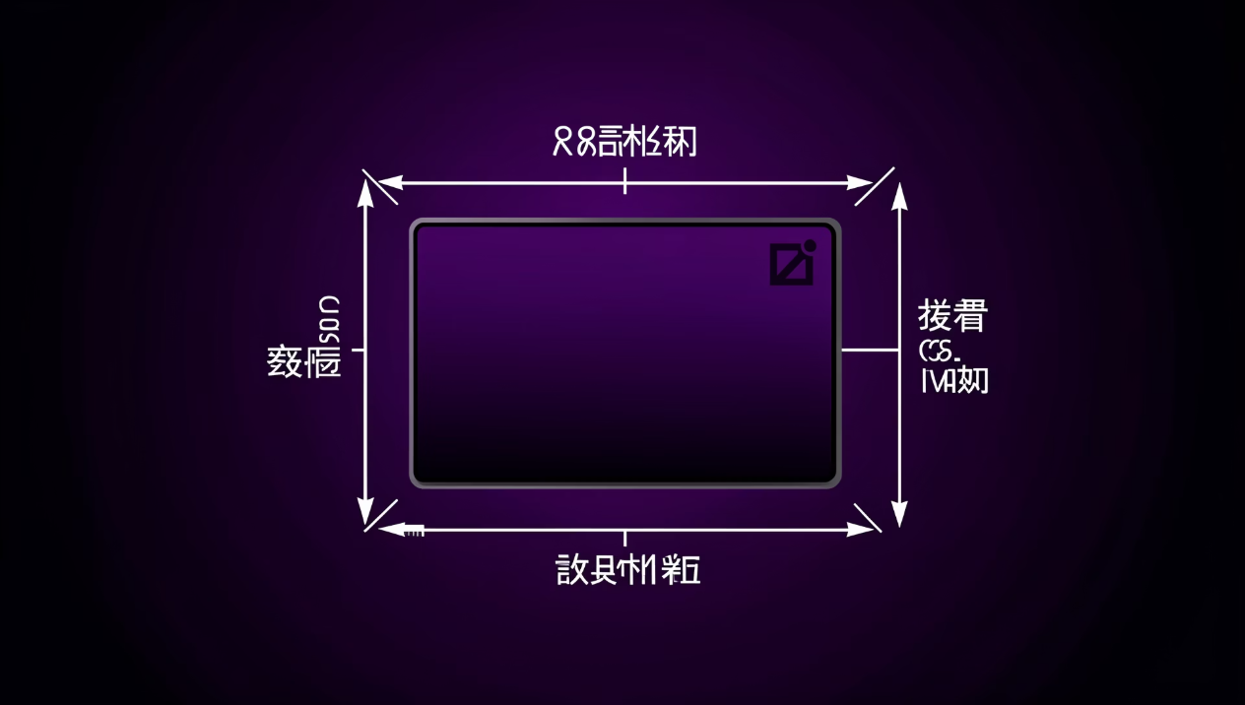
2️⃣ CSS Margin
🔹 Concept
Margin is the space outside an element's border.
It controls the distance between elements.
Think of margin as personal space between boxes.
🔹 Why Margin is Important
Prevents elements from touching each other.
Creates clean layouts.
Improves readability.
Used for centering elements.
🔹 Margin Properties
margin-top
margin-right
margin-bottom
margin-left
Shorthand
margin: 10px 20px 15px 5px;
Order: Top → Right → Bottom → Left (Clockwise rule)
🔹 Special Values
1. auto
2. Negative Margin
Used for horizontal centering.
margin-top: -10px;
div {
width: 300px;
margin: auto;
}
Moves element upward or inward.
🔹 Margin Collapsing (Advanced Concept)
When two vertical margins meet, the larger one is applied instead of adding them.
Example: If one element has margin-bottom: 20px And the next has margin-top: 30px The space becomes 30px (not 50px).

Slide 4
3️⃣ CSS Padding
🔹 Concept
Padding is the space inside an element, between content and border.
Think of padding as cushioning inside a box.
🔹 Why Padding is Important
Prevents text from touching borders.
Makes buttons look better.
Improves user experience.
Increases clickable area.
🔹 Padding Properties
padding-top
padding-right
padding-bottom
padding-left
Shorthand
padding: 10px 20px;
🔹 Important Difference Between Margin and Padding
Margin
Padding
Outside the element
Inside the element
Separates elements
Adds internal space
Can collapse
Does not collapse
4️⃣ CSS Width
🔹 Concept
Width controls how wide an element is.
By default:
Block elements take full width.
Inline elements ignore width unless changed.
🔹 Units of Width
Absolute Units
Relative Units
px (pixels)
%
em
rem
vw (viewport width)
Example:
width: 50%;
Means 50% of parent element width.
🔹 max-width and min-width
max-width: 600px;
min-width: 200px;
Used for responsive design.

Slide 5
5️⃣ CSS Height
🔹 Concept
Height defines how tall an element is.
Unlike width, height should be used carefully.
Why?
Because content may grow and overflow.
🔹 Best Practice
Instead of fixed height, use:
min-height
max-height
🔹 Overflow Problem
If height is fixed and content is larger:
overflow: hidden;
overflow: scroll;
overflow: auto;

Slide 6
6️⃣ CSS Text Properties
Text properties control the appearance of written content.
🔹 Text Color
🔹 Text Alignment
🔹 Text Decoration
color: red;
text-align:
left;
center;
right;
justify;
text-decoration:
underline;
line-through;
none;
Accepts:
Color names
HEX codes
RGB values
Used for:
Links
Emphasis
🔹 Text Transform
🔹 Line Height
🔹 Letter Spacing
text-transform:
uppercase;
lowercase;
capitalize;
Controls vertical spacing between lines.
letter-spacing: 2px;
line-height: 1.6;
Improves readability.
🔹 Text Shadow
text-shadow: 2px 2px 5px gray;
Adds visual effect.

Slide 7
7️⃣ CSS Fonts
Fonts determine how text looks stylistically.
🔹 Font Family
font-family: Arial, Helvetica, sans-serif;
Always provide fallback fonts.
Font Categories
Serif
Sans-serif
Monospace
Cursive
Fantasy
🔹 Font Size
font-size: 16px;
Best practice: Use rem for responsive design.
🔹 Font Weight
font-weight: bold;
font-weight: 700;
Range: 100 – 900
🔹 Font Style
font-style: italic;
🔹 Font Variant
font-variant: small-caps;
🔹 Font Shorthand
font: italic bold 16px/1.5 Arial, sans-serif;
Order: style → weight → size → line-height → family

Slide 8

🎯 Relationship Between These Properties
When designing a webpage:
Width & Height define size.
Padding defines internal spacing.
Margin defines external spacing.
Fonts define style.
Text properties improve readability.
All work together to create:
Good layout
Professional design
User-friendly interface

Slide 9
🧠 Teaching Strategy
When teaching:
Start with Box Model diagram.
Demonstrate live examples.
Let students change values.
Show bad design vs good design.
Assign mini-project: Create a styled card or profile box.

Slide 10
📝 Class Practical Task
Ask students to:
Create a div.
Set width and height.
Add padding.
Add margin.
Style text and font.
Add border.
Compare layout before and after.

